Slide 1
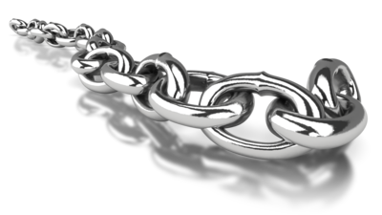
Technical Deep Dive into Hyperledger Fabric v1.0 14 Nov 2017

Slide 2
Agenda

Slide 3
Hyperledger Project

Slide 4
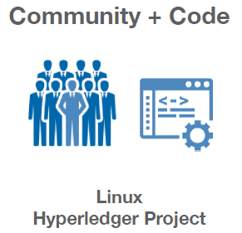
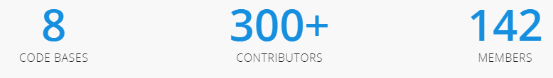
What is Hyperledger Project?
Linux Foundation project announced on 17 December 2015
Hyperledger project aims to transform the way business transactions are conducted around the world
An open source, collaborative development strategy supporting multiple players in multiple industries
Several companies have submitted candidates for the base code;

Slide 5
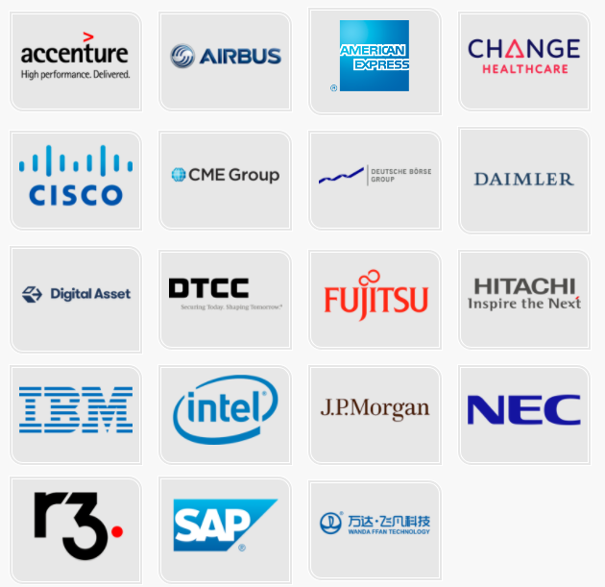
Hyperledger Premier Members

Slide 6
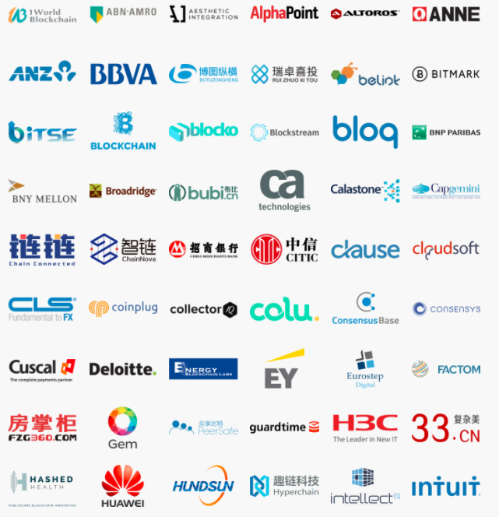
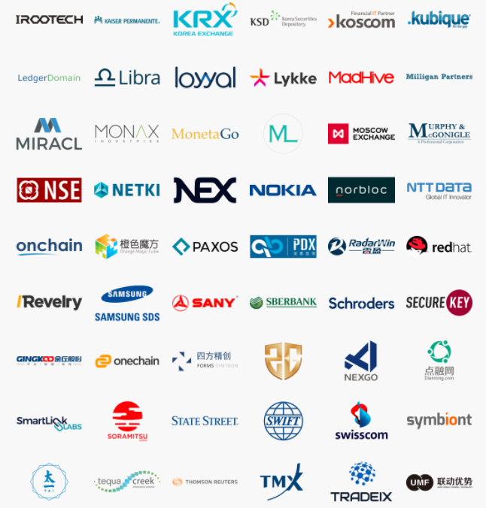

Hyperledger General Members

Slide 7
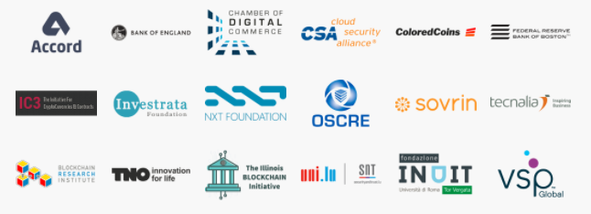
Hyperledger Associate Members

Slide 8
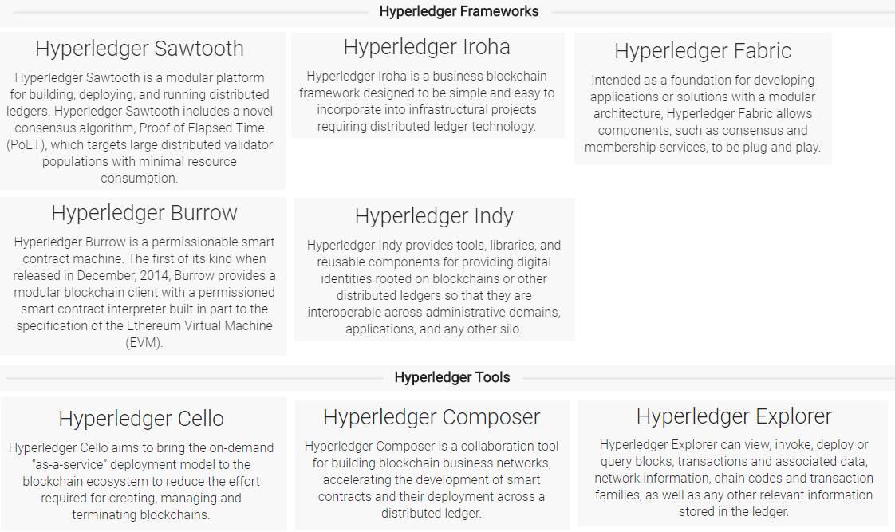
Projects Under Hyperledger Umbrella

Slide 9
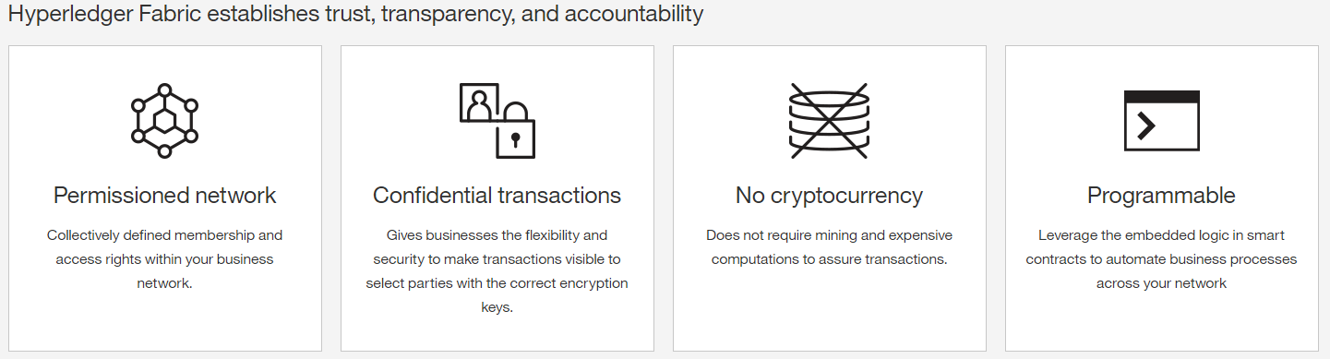
What is Hyperledger Fabric (HLF)?
IBM’s implementation of Blockchain technology
It include nodes, APIs, membership services, and more
Provides a permissioned network, with known identities
No cryptocurrencies
Provides a foundation for developing Blockchain solutions with a modular architecture, pluggable implementations, and container technology

Slide 10
Hyperledger Fabric Vs Ehtereum Vs Ripple Vs Bitcoin
 | Hyperledger Fabric | Ethereum | Ripple | Bitcoin
Description of Platform | General purpose Blockchain | General purpose Blockchain | Payments Blockchain | Payments Blockchain
Governance | Linux Foundation | Ethereum Developers | Ripple Labs | Bitcoin Developers
Currency | None | Ether | XRP | BTC
Mining Reward | N/A | Yes | No | Yes
State | Key-value database | Account data | None | Transaction data
Consensus Network | Pluggable : Solo/Kafka/SBFT | Mining | Ripple Protocol | Mining
Network | Private | Public or Private | Public | Public
Privacy | Open to Private | Open | Open | Open
Smart Contracts | Multiple programming languages like Java, GO. | ‘Solidity’ programming language | None | Possible, but not obvious

Slide 11
Architecture

Slide 12
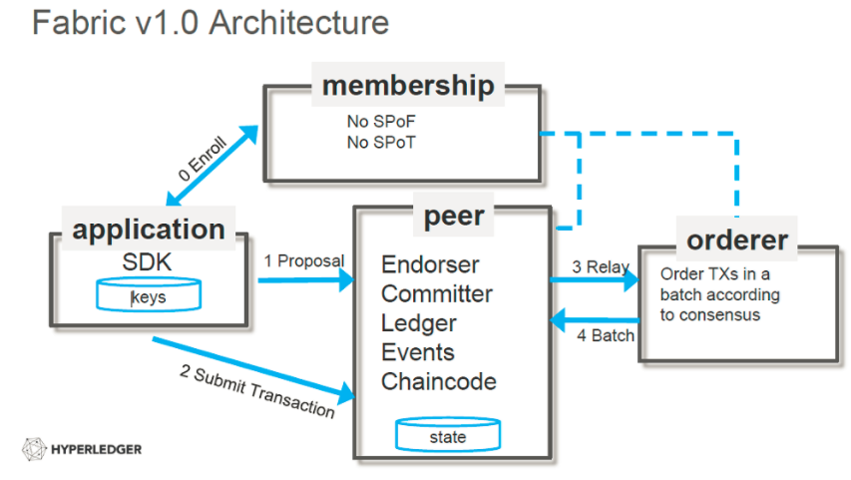
Hyperledger Fabric v1.0 Architecture

Slide 13
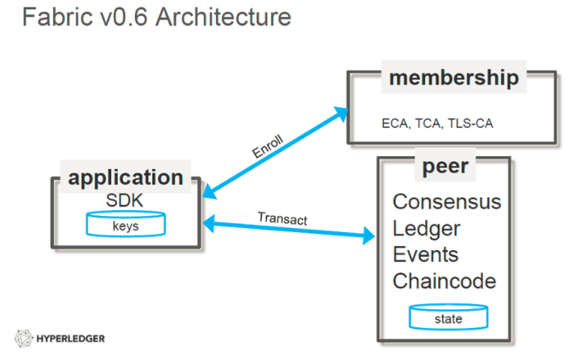
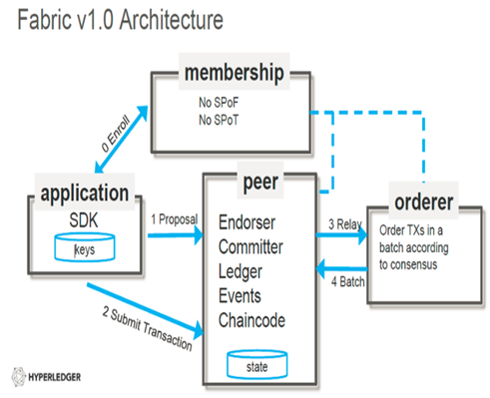
Hyperledger Fabric v0.6 Vs v1.0 Architecture

Slide 14
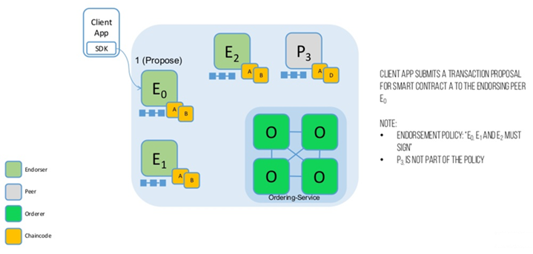
Architecture Flow v1.0 (1/7): PROPOSE

Slide 15
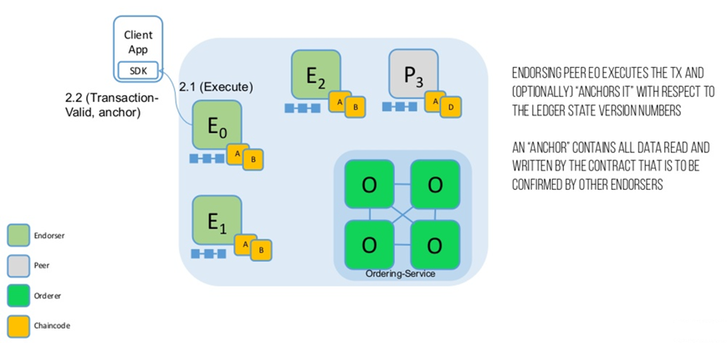
Architecture Flow v1.0 (2/7): EXECUTE

Slide 16
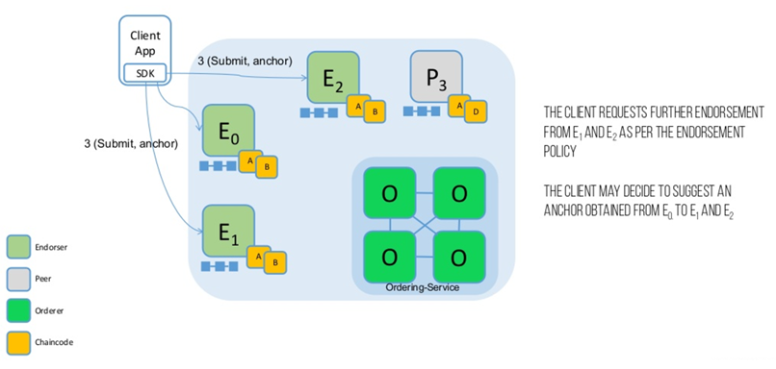
Architecture Flow v1.0 (3/7): SUBMIT

Slide 17
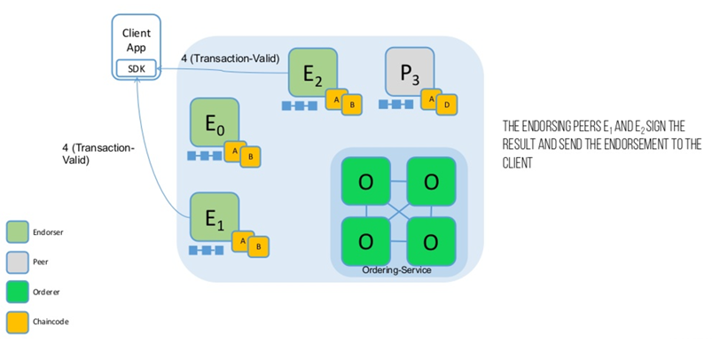
Architecture Flow v1.0 (4/7): ENDORSE

Slide 18
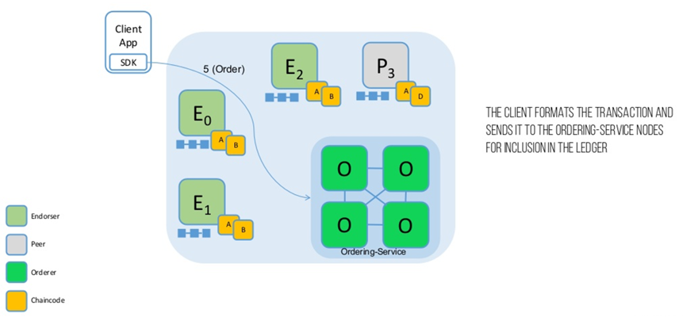
Architecture Flow v1.0 (5/7): ORDER

Slide 19
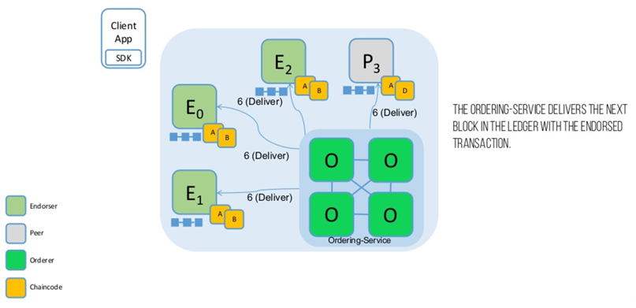
Architecture Flow v1.0 (6/7): DELIVER

Slide 20
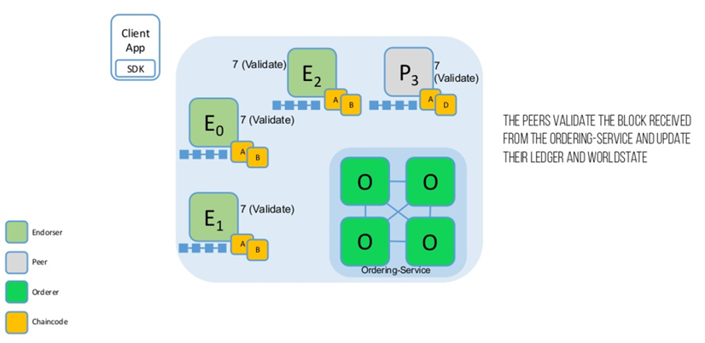
Architecture Flow v1.0 (7/7): VALIDATE

Slide 21
Transaction

Slide 22
Transaction Lifecycle v1.0
Client application creates transaction proposal (chaincode function and arguments) and sends to endorsing peer(s).
Endorsing peer executes chaincode, generates ReadWriteSet based on keys that were read and written.
Endorsing peer(s) send back proposal response (including response payload and ReadWriteSet) to client application
Client application may or may not submit as a transaction to ordering service. Transaction includes ReadWriteSet from proposal response
If client application submitted as transaction, ordering service packages the transaction into a block of ordered transactions.
Blocks are delivered to all peers (including the original endorsing peers).
Peers validate and commit block trans:
runs validation logic (VSCC to check endorsement policy, and MVCC to check that ReadSet versions haven't changed in State DB since simulation time)
indicates in block which trans are valid and invalid
commits block to blockchain on file system, and commits valid transactions within block to state database ‘atomically’
fires events so that application client listening via SDK knows which transactions were valid/invalid

Slide 23
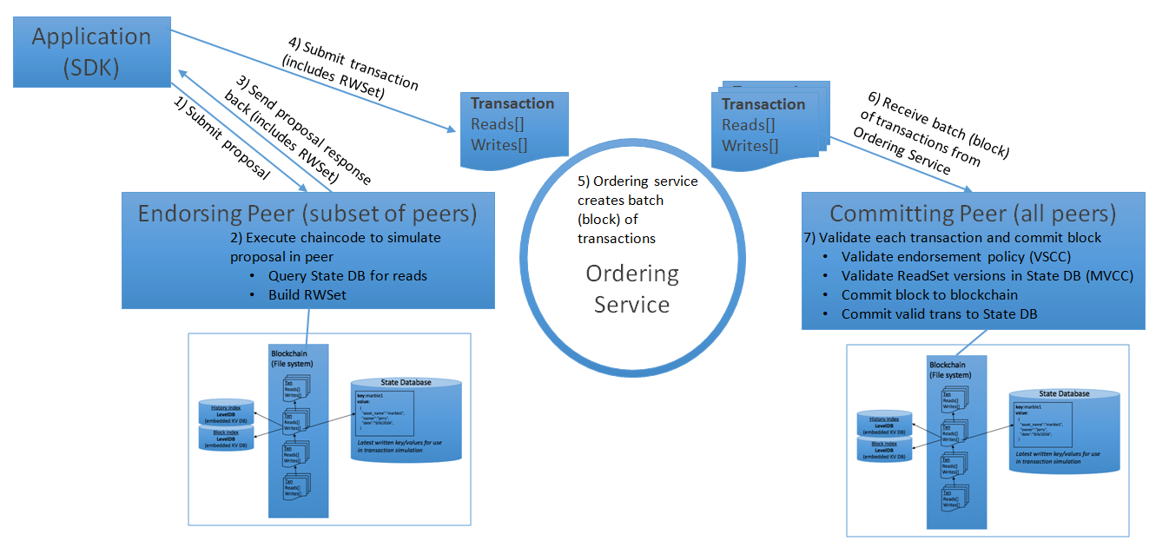
Transaction Lifecycle v1.0 with State DB

Slide 24
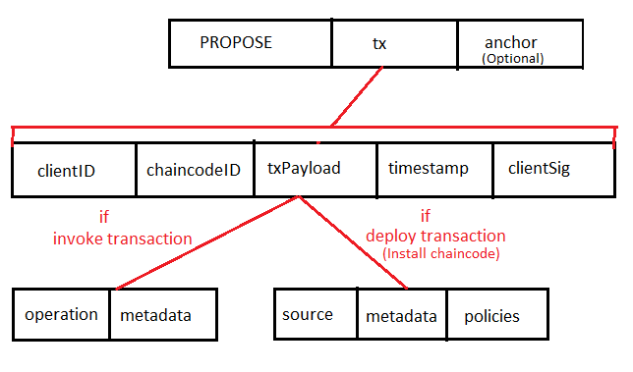
Client’s Proposal Message Format
clientID is an ID of the submitting client,
chaincodeID refers to the chaincode to which the transaction pertains,
txPayload is the payload containing the submitted transaction itself,
timestamp is a monotonically increasing (for every new transaction) integer maintained by the client,
clientSig is signature of a client on other fields of tx.
anchor contains read version dependencies, or more specifically, key’s read version in the world state (readset).
operation denotes the chaincode operation (function) and arguments,
metadata denotes attributes related to the invocation.
source denotes the source code of the chaincode,
metadata denotes attributes related to the chaincode and application,
policies contains policies related to the chaincode such as the endorsement policy.
Note: If the client specifies the anchor argument, an endorser endorses a transaction only upon read version numbers of corresponding keys in its local KVS match anchor.

Slide 25
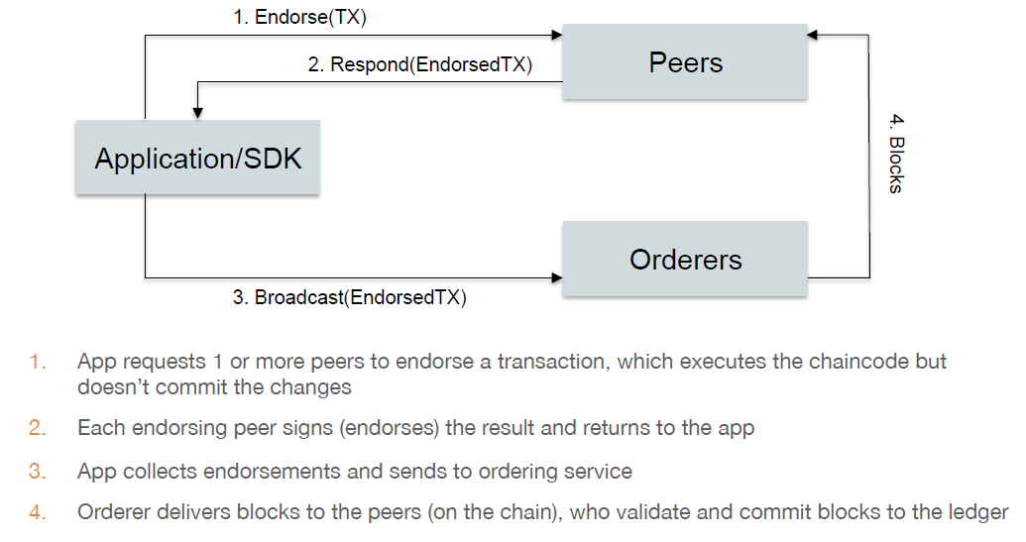
Transaction Data Flow

Slide 26
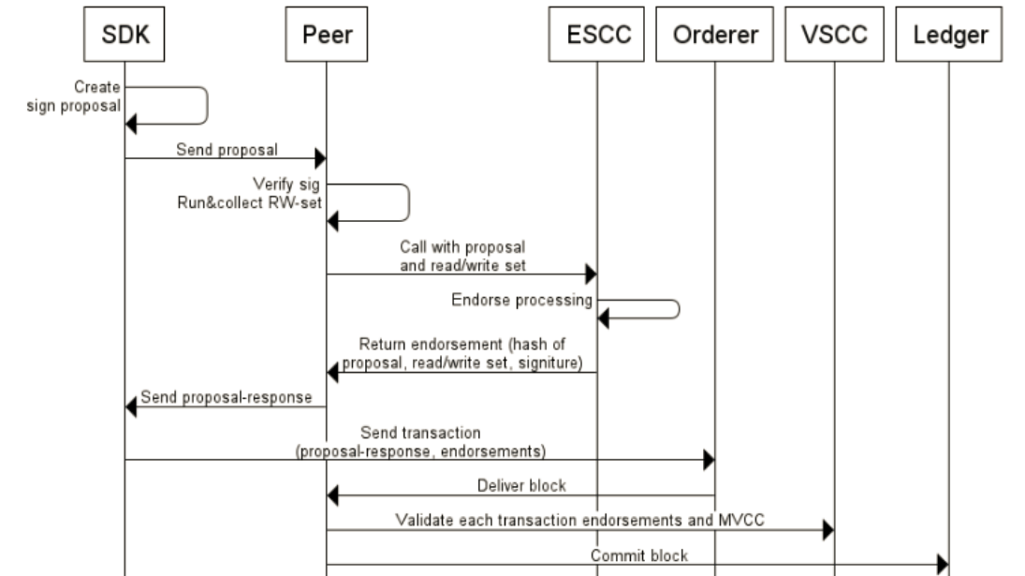
Transaction Flow Inside a Peer

Slide 27
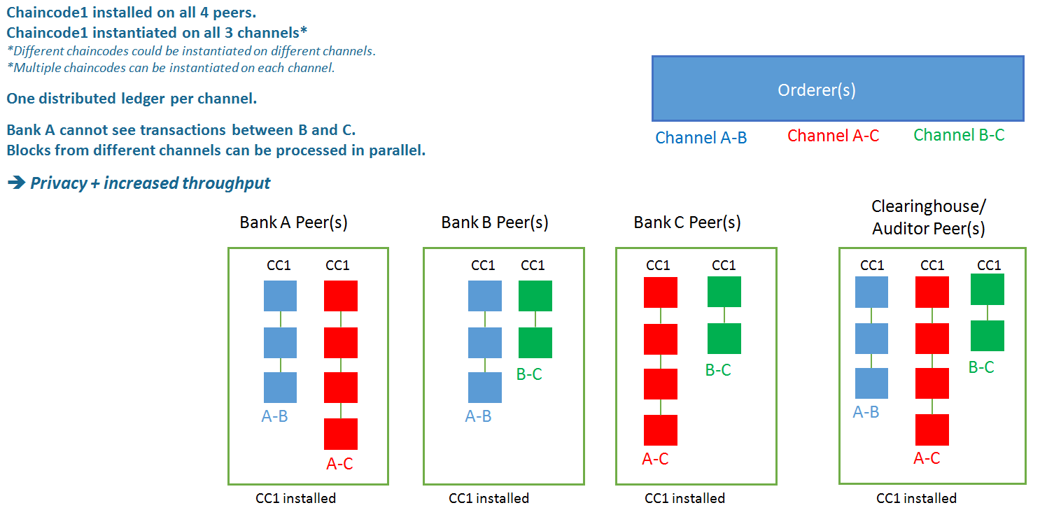
Example Scenario with Multi-Channel

Slide 28
Protocols

Slide 29
Gossip: Data Distribution Protocol
Hyperledger Fabric optimizes blockchain network performance, security and scalability by dividing workload across transaction execution (endorsing and committing) peers and transaction ordering nodes. This decoupling of network operations requires a secure, reliable and scalable data dissemination protocol to ensure data integrity and consistency. To meet these requirements, the fabric implements a gossip data dissemination protocol.
gossip protocol guaranteeing data consistency and integrity across the channel. Each peer on a channel periodically send its data to randomly-selected peers on the same channel. Each peer on a channel is continuously receiving current and consistent data from multiple peers. Any data that is transmitted from a Byzantine node, which is neither current nor consistent, is identified and filtered out of the network (channel).

Slide 30
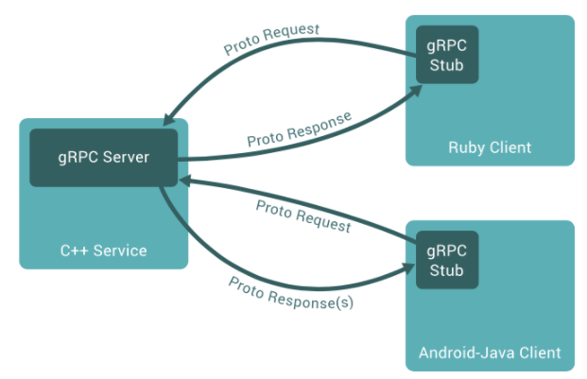
gRPC: Communication Protocol
gRPC is a high performance, open-source remote procedure call (RPC) framework similar to CORBA that can run anywhere. It enables client and server applications to communicate transparently, and makes it easier to build connected systems. The gRPC framework is developed and open-sourced by Google. gRPC uses standards based HTTP/2 as transport allowing it to easily traverse proxies and firewalls.

Slide 31
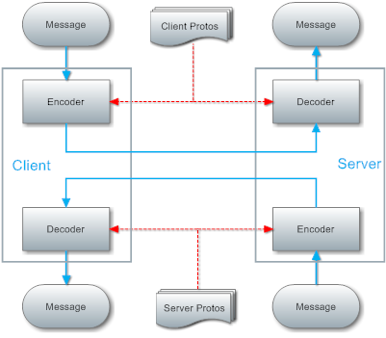
Protocol Buffer: Serialization Framework
Protocol Buffers are a way of encoding structured data in an efficient yet extensible format. Protocol Buffer uses gRPC as it’s communication protocol. software developer defines data structures (called messages) and services in a proto definition file (.proto) and compiles it with protoc.

Slide 32
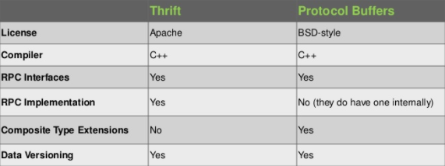
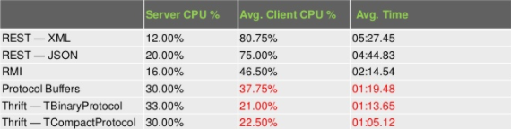
Protocol Buffer Vs Thrift

Slide 33
Smart Contract

Slide 34
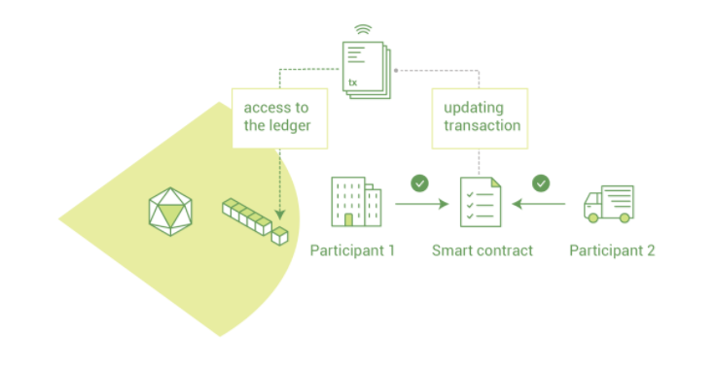
Overview
Smart contracts implement business logic specifically oriented towards a blockchain's distributed, transparent ledger. Smart contracts service two classes of message:
transactions, which change ledger state, and
queries, which read ledger state

Slide 35
Chaincode
The widely-used term, smart contract, is referred to as "chaincode" in Hyperledger Fabric.
Chaincode is a program contains business logic. Chaincode initializes and manages the ledger state through transactions submitted by applications.
The supported chaincode language is Go and Java. They are also looking into developing a templating language (such as Apache Velocity).
Two types of chaincode:
User-defined chaincode is encapsulated in a Docker container;
System chaincode runs in the same process as the peer;

Slide 36
Chaincode API
main() - main function starts up the chaincode in the container during instantiate
Init() - Init is called during chaincode instantiation to initialize any data. Note that chaincode upgrade also calls this function to reset. This is similar to constructor in Java.
Invoke() - Invoke is called per transaction on the chaincode. Each transaction is either a 'get' or a 'set' on the asset created by Init function. The 'set‘ method may create a new asset by specifying a new key-value pair. Note, this is the only function from where you can call other user defined functions for better code modularity. E.g query(), delete(), get(), set() etc.

Slide 37
Chaincode Interface (shim.ChaincodeStubInterface)
GetStringArgs() []string - GetStringArgs returns the arguments intended for the chaincode Init and Invoke as a string array. Only use GetStringArgs if the client passes arguments intended to be used as strings.
GetFunctionAndParameters() (string, []string) - GetFunctionAndParameters returns the first argument as the function name to be called and the rest of the arguments as parameters in a string array.
GetTxID() string - GetTxID returns the tx_id of the transaction proposal.
GetState(key string) ([]byte, error) - GetState returns the value of the specified `key` from the ledger. If the key does not exist in the state database, (nil, nil) is returned. Note that GetState doesn't read data from the writeset, which has not been committed to the ledger.
PutState(key string, value []byte) error - PutState puts the specified `key` and `value` into the transaction's writeset as a data-write proposal. Note that PutState doesn't effect the ledger until the transaction is validated and successfully committed.
DelState(key string) error - DelState records the specified `key` to be deleted in the writeset of the transaction proposal. The `key` and its value will be deleted from the ledger when the transaction is validated and successfully committed.

Slide 38
User Vs System Chaincode
System chaincode has the same programming model except that it runs within the peer
process rather than in an isolated container like normal chaincode. Therefore, system
chaincode is built into the peer executable.

Slide 39
List of System Chaincode
LSCC Lifecycle system chaincode handles lifecycle requests described above.
CSCC Configuration system chaincode handles channel configuration on the peer side.
QSCC Query system chaincode provides ledger query APIs such as getting blocks and transactions.
ESCC Endorsement system chaincode handles endorsement by signing the transaction proposal response.
VSCC Validation system chaincode handles the transaction validation, including checking endorsement policy and multiversioning concurrency control.

Slide 40
Install Chaincode
The install transaction packages a chaincode’s source code into a prescribed format called
a ChaincodeDeploymentSpec (or CDS) and installs it on a peer node that will run that
chaincode. Note: You must install the chaincode on each endorsing peer (one peer in each
organisation) node of a channel that will run your chaincode.

Slide 41
Peer

Slide 42
Overview
In Peer-to-Peer architectures where there are no special machines that provide a service or manage the network resources. Instead all responsibilities are uniformly divided among all machines, known as peers. Peers can serve both as clients and as servers.
Fabric define Peer as a network entity that maintains a ledger and runs chaincode containers in order to perform read/write operations to the ledger. Peers are owned and maintained by members.

Slide 43
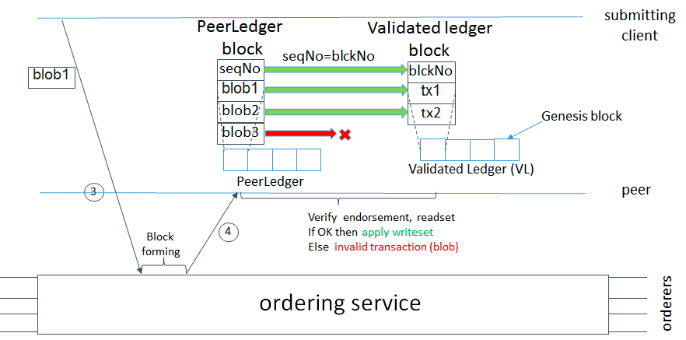
PeerLedger (Ledger Checkpointing)
Peer maintain PeerLedger (with valid and invalid transactions), State and additionally Validated Ledger (valid transactions only). Invalid transactions are filtered out and only valid transactions block get added into VLedger through checkpointing process.

Slide 44
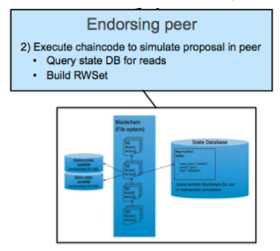
Endorseing Peer
Refers to the process where specific peer nodes execute a transaction and return a YES/NO response to the client application that generated the transaction proposal. Chaincode applications have corresponding endorsement policies, in which the endorsing peers are specified.

Slide 45
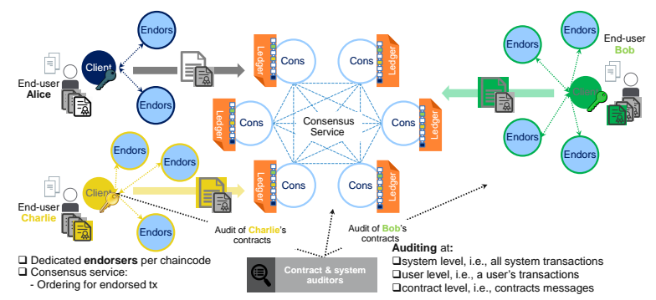
Separating Transaction Endorsement from Consensus

Slide 46
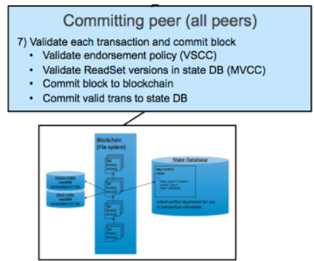
Committing Peer
Maintainers of the ledger, a.k.a the committer nodes. Note that all peers are always committers.

Slide 47
Anchor Peer
Each Member(Organisation) on a channel has an anchor peer (or multiple anchor peers to prevent single point of failure), allowing for peers belonging to different Members(Organisations) to discover all existing peers that are available on a channel.

Slide 48
Leading Peer
The election of a leading peer for each member on a channel determines which peer communicates with the ordering service on behalf of the member. If no leader is identified, an algorithm can be used to identify the leader. The consensus service orders transactions and delivers them, in a block, to each leading peer, which then distributes the block to its member peers, and across the channel, using the gossip protocol.

Slide 49
Ledger

Slide 50
Overview
Ledger provides a verifiable history of all successful state changes (valid transactions) and unsuccessful attempts to change state (invalid transactions), occurring during the operation of the system.
Ledger is constructed by the ordering service as a totally ordered hashchain of blocks of (valid or invalid) transactions. The hashchain imposes the total order of blocks in a ledger and each block contains an array of totally ordered transactions. This imposes total order across all transactions.
There are two types of ledger:
PeerLedger
OrdererLedger
Note: PeerLedger differs from the OrdererLedger in that peers locally maintain a bitmask that tells apart valid transactions from invalid ones

Slide 51
Ledger (Chain + State)
The ledger is the sequenced, tamper-resistant record of all state transitions in the fabric. State transitions are a result of chaincode invocations ('transactions') submitted by participating parties. Each transaction results in a set of asset key-value pairs that are committed to the ledger as creates, updates, or deletes.
The ledger is comprised of a blockchain ('chain') to store the immutable, sequenced record in blocks, as well as a state database to maintain current fabric state. There is one ledger per channel. Each peer maintains a copy of the ledger for each channel of which they are a member.

Slide 52
Chain
The chain is a transaction log, structured as hash-linked blocks, where each block contains a sequence of N transactions. The block header includes a hash of the block's transactions, as well as a hash of the prior block's header. In this way, all transactions on the ledger are sequenced and cryptographically linked together. In other words, it is not possible to tamper with the ledger data, without breaking the hash links. The hash of the latest block represents every transaction that has come before, making it possible to ensure that all peers are in a consistent and trusted state.
The chain is stored on the peer file system (either local or attached storage), efficiently supporting the append-only nature of the blockchain workload.

Slide 53
State
The ledger's current state data represents the latest values for all keys ever included in the chain transaction log. Since current state represents all latest key values known to the channel, it is sometimes referred to as World State.
Chaincode invocations execute transactions against the current state data. To make these chaincode interactions extremely efficient, the latest values of all keys are stored in a state database. The state database is simply an indexed view into the chain's transaction log, it can therefore be regenerated from the chain at any time. The state database will automatically get recovered (or generated if needed) upon peer startup, before transactions are accepted.

Slide 54
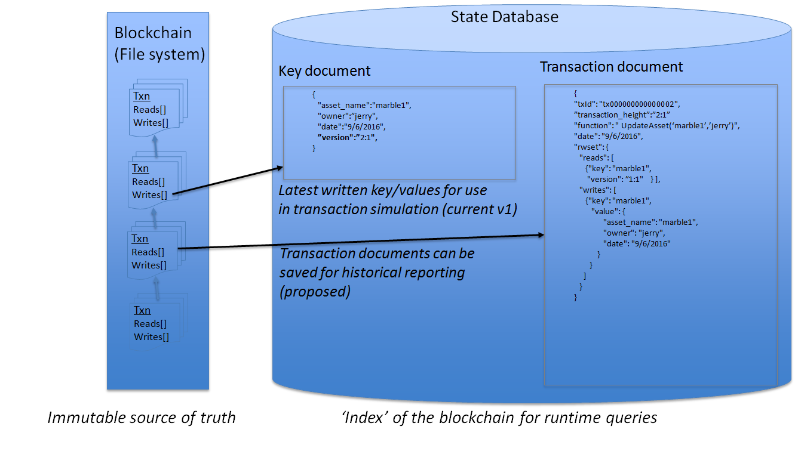
Ledger v1.0

Slide 55
Consensus

Slide 56
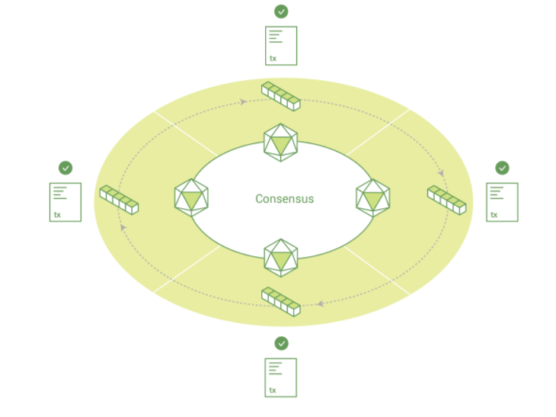
Overview
A broader term overarching the entire transactional flow, which serves to generate an agreement on the order and to confirm the correctness of the set of transactions constituting a block.

Slide 57
Modular consensus in Fabric V1.0
There are three pluggable consensus mechanism available in Fabric v1.0. These are:
"Solo orderer"
One host only, acting as specification during development (ideal functionality)
Apache Kafka, a distributed pub/sub streaming platform
Tolerates crashes among member nodes, has Apache Zookeeper
Focus on high throughput
Each channel maps to a separate single-partition topic in Kafka.
SBFT - A simple implementation of Practical Byzantine Fault Tolerance (PBFT)
Tolerates f < n/3 Byzantine faulty nodes among n
Focus on resilience

Slide 58
State DB

Slide 59
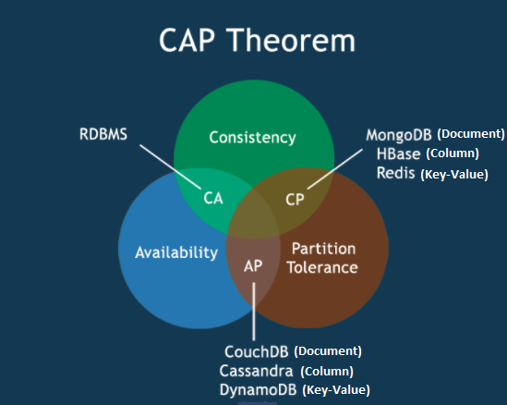
Selection of a NoSQL DB as State DB
Consistency: The consistency property describes a consistent view of data on all nodes of the distributed system.
Availability: A guarantee that nodes always answer queries and accept updated.
Partition tolerance: System continues working even if one or more nodes become silent or not responsive.

Slide 60
State Database options - Queryability
In a key/value database such as LevelDB, the content is a blob and only queryable by key
Does not meet chaincode, auditing, reporting requirements for many use cases
In a document database such as CouchDB, the content is JSON and fully queryable
Meets a large percentage of chaincode, auditing, and simple reporting requirements
For deeper reporting and analytics, replicate data to an analytics engine such as Spark (future)
Id/document data model compatible with existing chaincode key/value programming model, therefore no application changes are required when modeling chaincode data as JSON
SQL data stores would require more complicated relational transformation layer, as well as schema management.

Slide 61
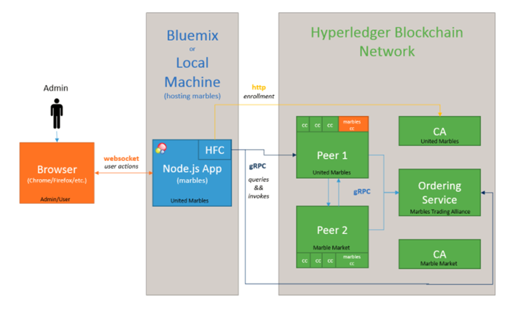
Application Communication Flow

Slide 62
Fabric CA

Slide 63
Overview
The Hyperledger Fabric CA is a Certificate Authority (CA) in Hyperledger Fabric.
It provides features such as:
Registration of identities, or connects to LDAP as the user registry
Issuance of Enrollment Certificates (ECerts)
Issuance of Transaction Certificates (TCerts)
Certificate renewal and revocation

Slide 64
Fabric PKI Components
Certificate Authority (CA)
Registration Authority (RA)
A certificate database
A certificate storage

Slide 65
List of Authorities in Fabric PKI
Root Certificate Authority - Root CA
Registration Authority (RA) – User management
Enrollment Certificate Authority (ECA) - Intermediate CA
Transaction Certificate Authority (TCA) - Intermediate CA
TLS Certificate Authority (TLS-CA) - Intermediate CA

Slide 66
Certificate Types in Fabric PKI
Enrollment Certificates (ECerts) - They are issued for all roles, i.e. users, peers, orderers.
Transaction Certificates (TCerts) - They are issued only to users.
TLS-Certificates (TLS-Certs) - TLS-Certs are certificates used for system-to-system/component-to-system/component-to-component communications.
Note: The ECA, TCA, and TLS CA certificates are self-signed, where the TLS CA is provisioned as a trust anchor (Root CA).

Slide 67
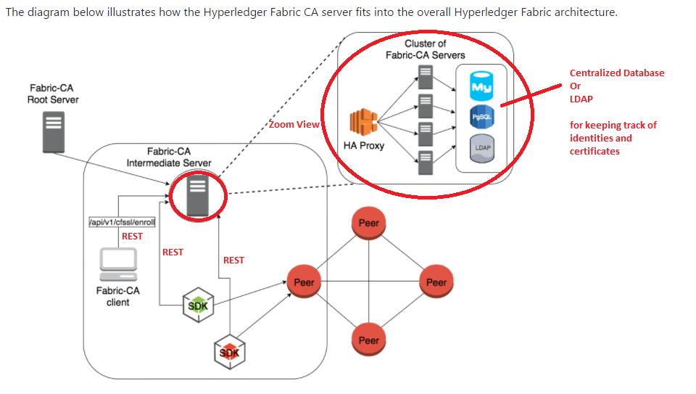
Fabric-CA Architecture

Slide 68
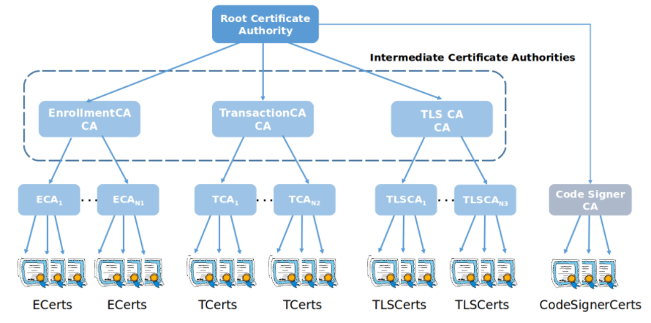
“Chain of Trust” Hierarchy in Fabric

Slide 69
Fabric Certificate
As of v1.0, identities are based on the Public Key Infrastructure (PKI) standards. Every orderer node, every peer node and every user/transactor must have a key pair with the public key wrapped in a x.509 certificate signed by a Certificate Authority (CA).
We will need a whole bunch of certificates because there are many identities involved:
peers need identities to sign endorsements
orderers need identities to sign proposed blocks for the committers to validate and append to the ledger
applications need identities to sign transaction requests
the Fabric CA themselves also need identities, so their signatures in the certificates can be validated

Slide 70
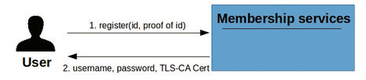
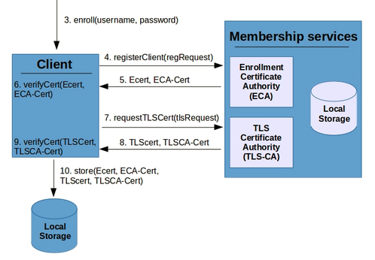
Enrollment Flow (User, Client, Peer, Orderer)

Slide 71
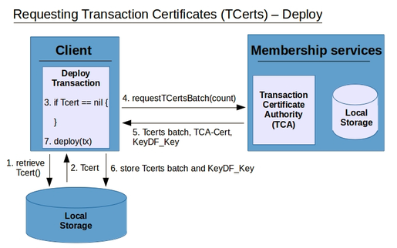
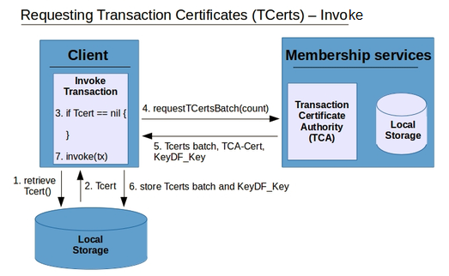
Transaction Flow (Deploy Tx & Invoke Tx)

Slide 72
Security and Privacy

Slide 73
Overview
Hyperledger Fabric underpins a transactional network where all participants have known identities. Public Key Infrastructure (PKI) is used to generate cryptographic certificates which are tied to organizations, network components, and end users or client applications. As a result, data access control can be manipulated and governed on the broader network and on channel levels. This “permissioned” notion of Hyperledger Fabric, coupled with the existence and capabilities of channels, helps address scenarios where privacy and confidentiality are paramount concerns.

Slide 74
PKI (Public Key Infrastructure)
Identities are established with x.509 certificates. Certificate to be considered valid on the Fabric, it must be signed by a trusted Certificate Authority (CA). Fabric supports any standard CAs. In addition, Fabric also provides a CA server. We will need a whole bunch of certificates because there are many identities involved:
peers need identities to sign endorsements.
orderers need identities to sign proposed blocks for the committers to validate and append to the ledger.
clients need identities to sign transaction requests.

Slide 75
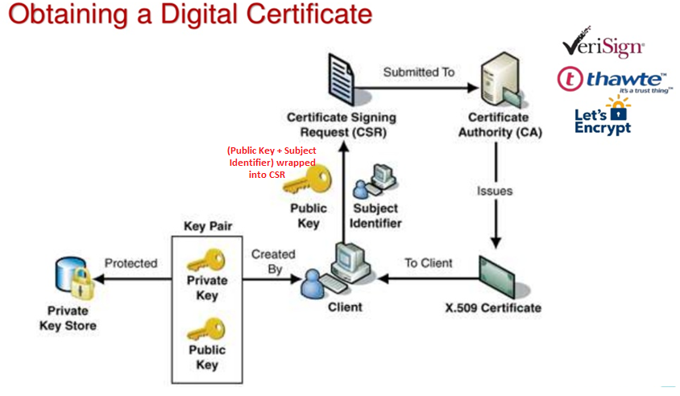
PKI (Certificate is signed by CA)

Slide 76
PKI (Self-signed Certificate)
Certificate is signed by own private key hence self-signed.
Best for development.
Very easy to generate locally with Fabric's cryptogen tool or OpenSSL.

Slide 77
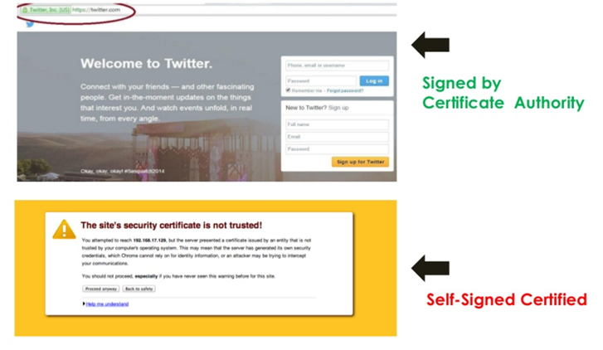
Self-Signed Certificate Vs Signed by Trusted CA

Slide 78
CSR - Certificate Signing Request
A Certificate Signing Request (CSR) is a request to sign a digital certificate. When you generate a certificate, the certificate signing request is sent to a trusted Certificate Authority (CA), such as VeriSign. The CA reads the CSR and returns a signed certificate to you. After you receive the signed certificate from the CA, you can use the signed certificate. Common attributes of a CSR:
Common Name (CN) The Fully Qualified Domain Name (FQDN) of your server. This must match exactly what you type in your web browse.
Organization The legal name of your organization.
City/State/Country
Email An email address used to contact your organization.
Public Key The public key that will go into the certificate. The public key is created automatically.

Slide 79
Generate a CSR using OpenSSL
Run openssl command. The command prompt changes to OpenSSL>
To generate a private key, at the OpenSSL> genrsa -out mykey.key 1024
To generate a CSR with the private key, at the OpenSSL> req -new -key mykey.key -text -out mycsr.csr
Add information about your organization to create a Distinguished Name (DN) for the CSR.
OpenSSL> req -in mycsr.csr -noout -text
OpenSSL> exit

Slide 80
Docker

Slide 81
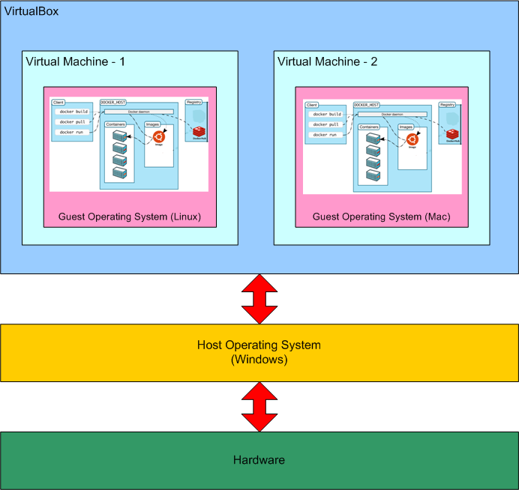
Docker Architecture

Slide 82
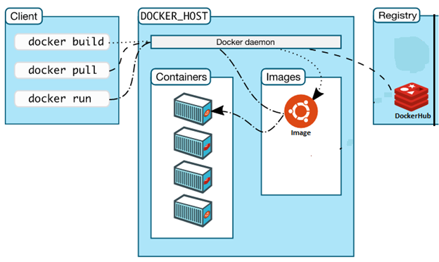
Docker Components

Slide 83
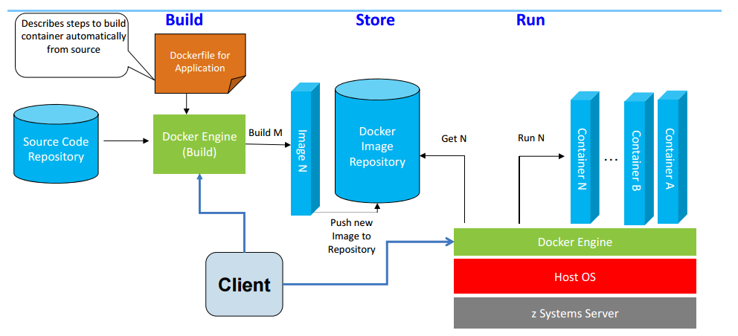
Docker Basic Functions

Slide 84
Software Development Kit (SDK)

Slide 85
Overview
The Hyperledger Fabric client SDK provides a structured environment of libraries for developers to write and test chaincode applications. The SDK is fully configurable and extensible through a standard interface. Components, including cryptographic algorithms for signatures, logging frameworks and state stores, are easily swapped in and out of the SDK. The SDK provides APIs for transaction processing, membership services, node traversal and event handling.
Supported SDK (Node.js, Java, Python, Go)
Node.js - https://github.com/hyperledger/fabric-sdk-node
Java - https://github.com/hyperledger/fabric-sdk-java
Python - https://github.com/hyperledger/fabric-sdk-py
Go - https://github.com/hyperledger/fabric-sdk-go

Slide 86
Some Features of the SDK
create a new channel
send channel information to a peer to join
install chaincode on a peer
instantiate chaincode in a channel
submitting a transaction
query a chaincode for the latest application state
various other query capabilities
monitoring events
supports both TLS (grpcs://) or non-TLS (grpc://) connections to peers and orderers
register a new user
enroll a user to obtain the enrollment certificate signed by the Fabric CA
revoke an existing user by enrollment ID

Slide 87
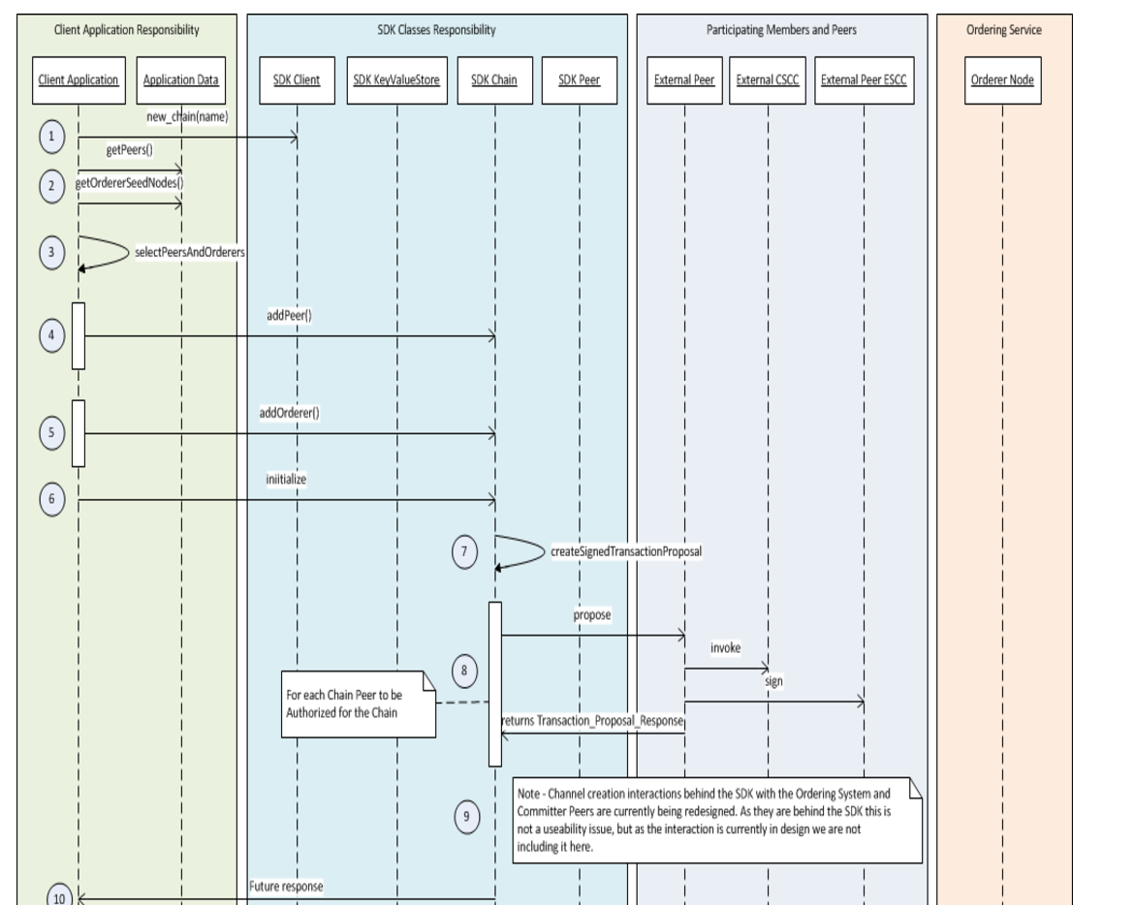
Node.js SDK Deployment Flow

Slide 88
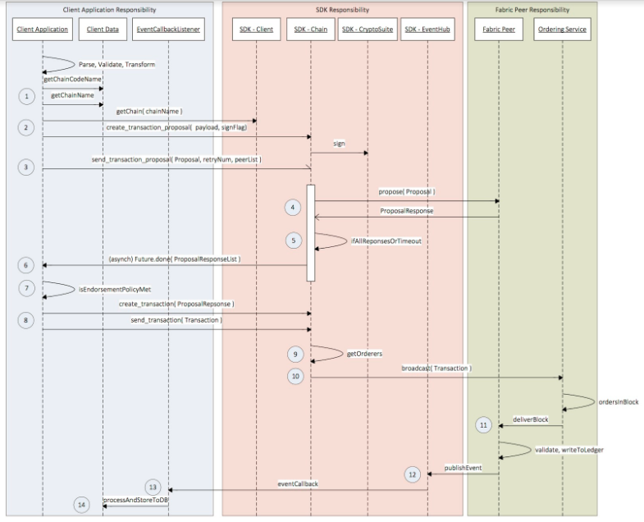
Node.js SDK Transaction Flow

Slide 89
Basic Understanding of Node.js
Node.js is an open source command line tool built for the server side JavaScript code. The JavaScript is executed by the V8 JavaScript Engine (developed by Google built for Google Chrome browser, Written in C++, V8 compiles JavaScript source code to native machine code instead of interpreting it in real time). Node.js uses asynchronous programming! (Non-blocking call through attach event based callback functions) with single-threaded to serve client requests. So, No multithreading / locking bugs. Another reason is JavaScript. You can use node to share code between the browser and your backend. And the last reason is raw speed by V8 engine.

Slide 90

Node.js Architecture

Slide 91
An Example: Node.js Vs Others
Here is how PHP or ASP handles a file request:
Sends the task to the computer's file system.
Waits while the file system opens and reads the file.
Returns the content to the client.
Ready to handle the next request.
Here is how Node.js handles a file request:
Sends the task to the computer's file system.
Ready to handle the next request.
When the file system has opened and read the file (through event), the server returns the content to the client.

Slide 92
Hyperledger Composer

Slide 93
Overview
Hyperledger Composer enables architects and developers to quickly create "full-stack" blockchain solutions. I.e. business logic that runs on the blockchain, REST APIs that expose the blockchain logic to web or mobile applications, as well as integrating the blockchain with existing enterprise systems of record.
Composer integrates well with a modern development best practices and tools: Atom and VisualStudio Code editors, GitHub for source code management, unit test using Mocha, npm for managing versioned binary artifacts, Travis CI and Jenkins for continuous integration, deployment using Docker images or as npm packages; so that developers and operations engineers can easily move applications from a development laptop to a managed cloud environment.
** The key concept for Composer is the Business Network Definition (BND). It defines the data model, business logic and access control rules (ACL) for your blockchain solution. It executes on Hyperledger Fabric.

Slide 94

Benefits of Fabric Composer

Slide 95

Open Toolset for Developers

Slide 96

Composer Architecture

Slide 97

Typical Composer Solution Architecture

Slide 98
Composer Connection Profile
**Note: A connection profile (connection.json) represents a single organisation interacting on a single channel. Of course in fabric you are allowed to submit transactions to other peers in different organisations so that connection profile can contain peers from other organisations but only for transaction submission. If you want to simulate handling of 2 or more organisations then you will need profiles for each organisation.

Slide 99

Getting Started with Composer
https://www.slideshare.net/dselman/hyperledger-composer-update-2017-0405

Slide 100

Composer Runtime Components
https://github.com/hyperledger/composer/tree/master/packages/composer-runtime

Slide 101

Composer Connector and Blockchain Platform
Note that there is a restriction currently for connection profiles to hlfv1. Although you can add multiple orderers to a connection profile, only the first one will receive the request. This is a limitation of the Hyperledger Fabric Node SDK.

Slide 102

Composer REST Server – Client Authentication

Slide 103

Hyperledger Composer Playground Web UI

Slide 104

Sample Business Network

Slide 105

Car Auction Business Network with Playground
https://composer-playground.mybluemix.net

Slide 106

Test Car Auction Business Network with Playground

Slide 107


Participants in a HLF Blockchain Network
User Roles in HLF:
Client - Validator
Auditor - Peer
A
C
B2B transactions
Blockchain
User
Regulator
performs oversight
Certificate Authority
accesses security certificates
C
Blockchain Developer
Blockchain
creates applications
operates
access to data
Traditional Data Sources
O
access to logic
Blockchain Network Operator
Traditional Processing Platforms

Slide 108

HLF Blockchain Components
Blockchain
Ledger
contains the current world state of the ledger and a Blockchain of transaction invocations
…
Smart Contract
f(abc);
encapsulates business network transactions in code. transaction invocations result in gets and sets of ledger state
Consensus
Network
a collection of network data and processing peers forming a Blockchain network. Responsible for maintaining a consistently replicated ledger
Membership
E
T
manages identity and transaction certificates, as well as other aspects of permissioned access
Events
creates notifications of significant operations on the Blockchain (e.g. a new block), as well as notifications related to smart contracts. Does not include event distribution.
Systems
Management
i
provides the ability to create, change and monitor Blockchain components
Wallet
securely manages a user’s security credentials
Systems Integration
responsible for integrating Blockchain bi-directionally with external systems. Not part of Blockchain, but used with it.

Slide 109


HLF Blockchain Application Flow
Blockchain User
Peer

Slide 110

Consensus and the HLF blockchain network

Slide 111

How a PBFT network works (1/3) —Submission

Slide 112

How a PBFT network works (2/3) —Ordering

Slide 113

How a PBFT network works (3/3) —Execution

Slide 114

HLF Ledger Access

Slide 115

Integrating HLF Blockchain with Existing Systems

Slide 116
Setting up HLF Development Environment on Windows machine
Prerequisites for setup:
Git Client (https://git-scm.com/download/win)
Google Golang 1.7 or later (https://golang.org/dl/)
Atom Editor (https://atom.io/)
Go Package for Atom (go-plus)
Download HLF v0.6 code from github as a zip file : https://github.com/hyperledger/fabric
Create folder C:\src\github.com\hyperledger and extract this zip file to this location
Rename fabric-0.6 to fabric
Under Environment Variables, set
GOPATH = C:\
Create folder structure ‘projects\chaincode’ for packaging chaincode as below C:\src\github.com\hyperledger\fabric\projects\chaincode
Open Atom and open the folder C:\src\github.com\hyperledger\fabric\projects\chaincode
Create a new go file to write the chaincode
Saving the file will compile the chaincode and report error, if any
Check in the chaincode file into git repository

Slide 117
Setting up HLF Network (Runtime) on Windows machine
Can be setup on Vagrant boxes or by using Docker images
Prerequisites for Docker based setup:
Git Client
Docker 1.12.2 or later
Virtual box 5.0 or later (installed automatically with Docker installation)
Admin Rights and BIOS Enabled Virtualization on Windows machine
Steps to setup HLF using Docker Images:
Open Git Bash (or any other shell prompt) and create a docker machine
docker-machine create --driver virtualbox singlenode
Set environment on this bash prompt
eval $(docker-machine env singlenode)
Pull docker images
docker pull hyperledger/fabric-peer
docker pull hyperledger/fabric-membersrvc
docker pull hyperledger/fabric-baseimage:x86_64-0.2.1
Run docker compose file
docker–compose up

Slide 118

Usecase - Car Leasing Business Network without Blockchain
Ownership Transfer
1. Manufacturer
2. Dealer
3. Leasing Company
4. Lessee
5. Scrap Merchant
“In house” (ledger)
“In house” (ledger)
“In house” (ledger)
“In house” (ledger)
“In house” (ledger)
Multiple ledgers
Who owns what, when, could get confused ?
Synchronisation:
Slow
Error prone
Regulator
“In house” (ledger)

Slide 119

Usecase - Car Leasing Business Network with HLF Blockchain
node
node
1. Manufacturer
Regulator
Shared Ledger
Smart Contracts
5. Scrap Merchant
2. Dealer
node
node
Records of asset transfer
Conditions for asset transfer
node
node
4. Lessee
3. Leasing Company

Slide 120
Q & A
If you like to get more information about #bitcoin #blockchain #cryptocurrencies and #permissionedledgers visit
Slack: https://satoshiroundtable.slack.com/ -> used for all public information and articles
For Slack Registration point your web browser to https://satoshiroundtable.slack.com/signup
Enter the part of your Capgemini email address before the @ symbol and click Create Account.
For getting invite to SRT Call -> Go to http://corporatedirectory.capgemini.com/
Click on ‘Public Distribution List’ on the left side. Look for entry ‘DL FSSBU SRT’ in the results. It will be on the second set of search results. Click on this entry. Click on ‘Edit’ from the list of Actions below. Check the Subscribed check for adding / Uncheck for removing yourself from the mailing list and Save
T-room: https://troom.capgemini.com/sites/Bitcoin_and_blockchain/ -> used for Capgemini specific materials
For Registration contact bart.cant@capgemini.com
For any other blockchain related queries contact devendra.chaudhari@capgemini.com

Slide 121
References
Fabric Protocol Specification - https://github.com/hyperledger/fabric/blob/master/docs/protocol-spec.md
Fabric Courses - https://developer.ibm.com/courses/all-courses/blockchain-for-developers
Fabric Documentation - http://hyperledger-fabric.readthedocs.io/en/latest

Slide 122
Thank you!

